Slide 1
Start learning R
Road to be data scientist
Zongcheng Li
生信小课堂二期

Slide 2
“I want to learn bioinformatics. Which programming language should I learn first?”
Python, R, and bash are the most useful languages to learn right now in bioinformatics. Deciding which one to start with depends on your goals…
From http://omgenomics.com/programming-languages/

Slide 3
Python vs R
统计，帮助文档，易用性，软件包，机器学习，计算效率，多面手

Slide 4
Install R packages
CRAN
https://cran.r-project.org/
>chooseCRANmirror()
>install.packages("devtools")
>require("devtools")
Bioconductor
https://cran.r-project.org/
>source("https://bioconductor.org/biocLite.R")
>chooseBioCmirror()
>biocLite("edgeR")
Github
https://github.com/
>devtools::install_github("hoesler/rwantshue")
Source
Downloaded to local
>install.packages("M3Drop.tar.gz", type="source")
pacman R package

Slide 5
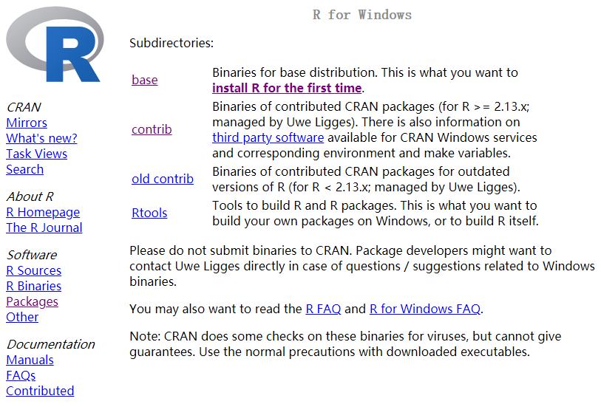
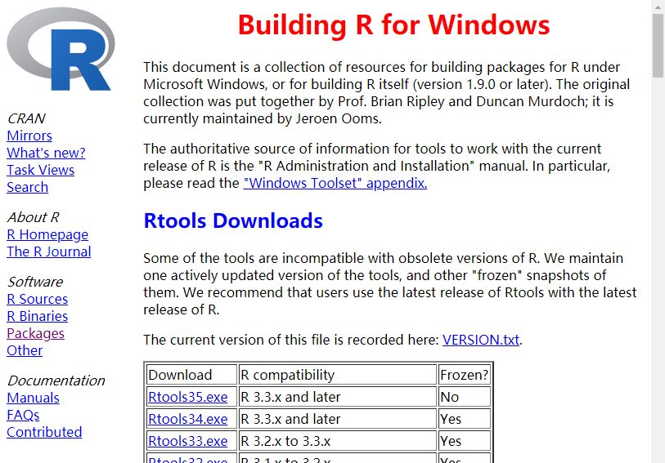
For Build R package from source codes

Slide 6
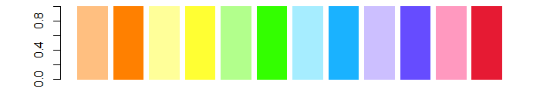

R Basics
R Programming
R visualization
R data analyses
Data-types/classes
numeric/integer
character/String
logical
factor
Checking class/type
is.numeric(x)
is.character(x)
is.logical(x)
is.factor(x)
Basic data structures
vector
matrix
data.frame
list ($ operator)
Tidy Data
Object
Variable (‘<-’)
Function
Argument (‘=‘)
Package
ggplot2 (gridExtra)
pheatmap
plotly
Colors in R
colors()
dichromat
RColorBrewer
t.test()
wilcox.test()
fisher.test()
phyper()
aov()
TukeyHSD()
survival
http://tools.medialab.sciences-po.fr/iwanthue/

Slide 7
Introduction to R (PDF)
Overview
R Package Repositories
Installation of R Packages
Getting Around
Basic Syntax
Data Types
Data Objects
Important Utilities
Operators and Calculations
Reading and Writing External Data
Useful R Functions
dplyr Environment
SQLite Databases
Graphics in R
Analysis Routine
R Markdown
Shiny Web Apps
Session Info
References
Programming in R (PDF)
Overview
Control Structures
Loops
Functions
Useful Utilities
Running R Scripts
Building R Packages
Programming Exercises
Homework 5
Session Info
References

Slide 8
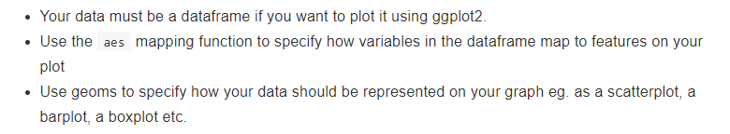
Principles of ggplot2
library(ggplot2)
library(dichromat)
ggplot(data = data) +
geom_point(mapping = aes(x = x, y = y, color = celltype)) +
geom_text(......) +
scale_color_manual(values = colorschemes$Categorical.12) +
theme(plot.title = element_text(face = ‘bold.italic’, hjust = 0.5))
Plotting heatmaps
Principle Component Analysis
Identify Differentially Expressed Genes

